Slide 1


WEBSITE CREATION
PROJECT 1
PRESENTATION

Slide 2

My name is Tharuna, and I'm excited to present you Technoble a SAP consultancy website revamp as my project for Digital Marketing Project
I have used WIX.com to do my project with the information I got from my client and used their old website for more details.
Also please note website is not yet published it is still in the testing stage. So I’m using this testing link https://wix.to/VY8VtJ9 which is under review by my client.
https://wix.to/VY8VtJ9

Slide 3

Understand their products or services and create short descriptions for a minimum of 3 and a maximum of 5 products or services.
Technoble is an SAP consultancy doing B2B for over a decade now. They offer services such as SAP Consulting, SAP Application Management & Support, and SAP Upgrade & Migration. They specialize in ERP service, and they also help clients to Strategies, design, develop, and easily launch this tool by providing well-trained people working on client locations for the convenience of clients.
https://wix.to/VY8VtJ9

Slide 4

Determine the platform on which the website is developed
Original website - https://technoble.co.in/ was built using JavaScript
Email Hosting Provider - Zoho
Website Hosting - Hostinger, Cogent Communication
CMS - WordPress
Information is Found Using BuiltWith online tool - https://builtwith.com/?https%3a%2f%2ftechnoble.co.in%2f
https://wix.to/VY8VtJ9

Slide 5
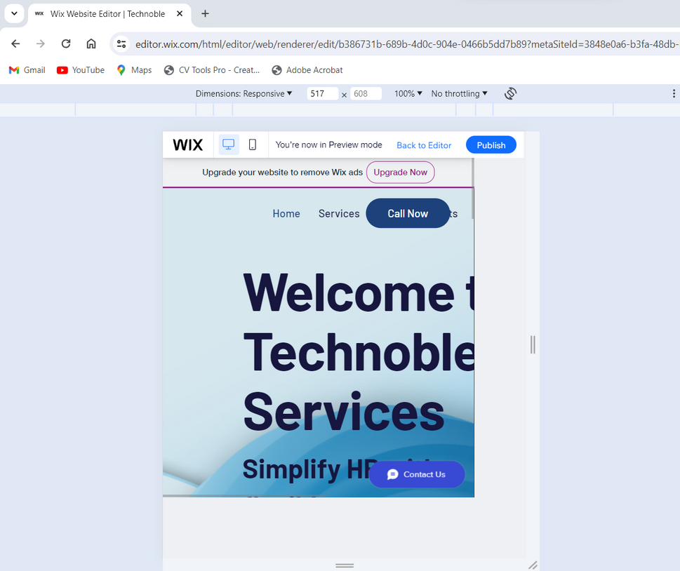
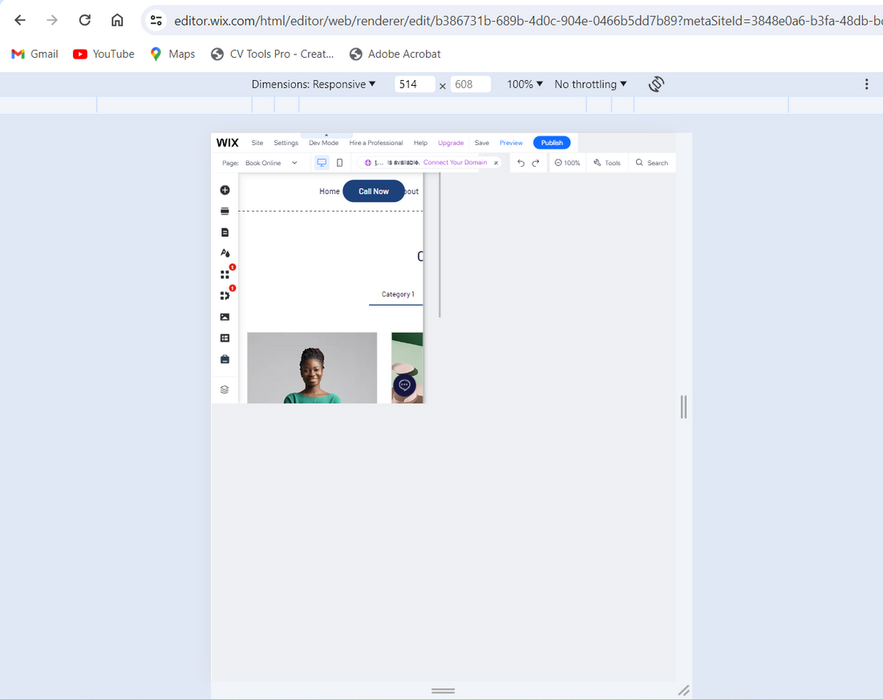
Test the website's responsive design and mobile optimization
I have tested the new website responsiveness and mobile optimization and the results shown on this and the following pages.
https://wix.to/VY8VtJ9

Slide 6
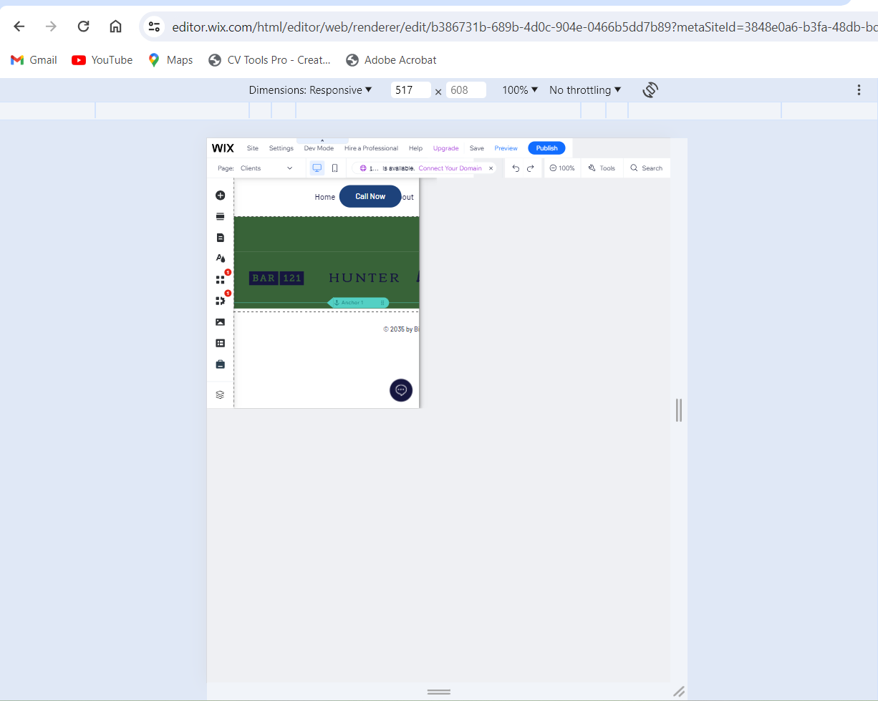
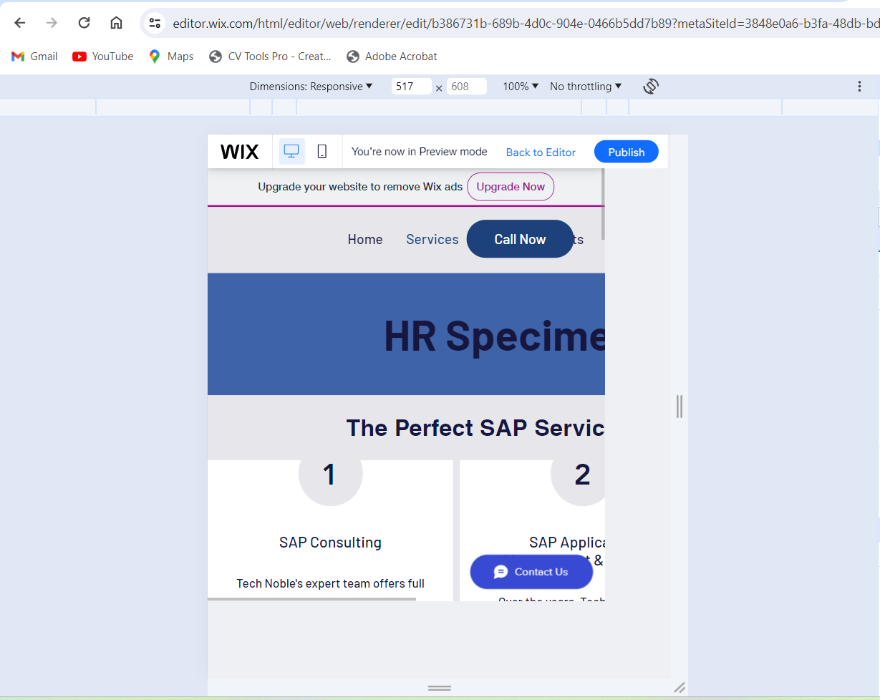
https://wix.to/VY8VtJ9

Slide 7
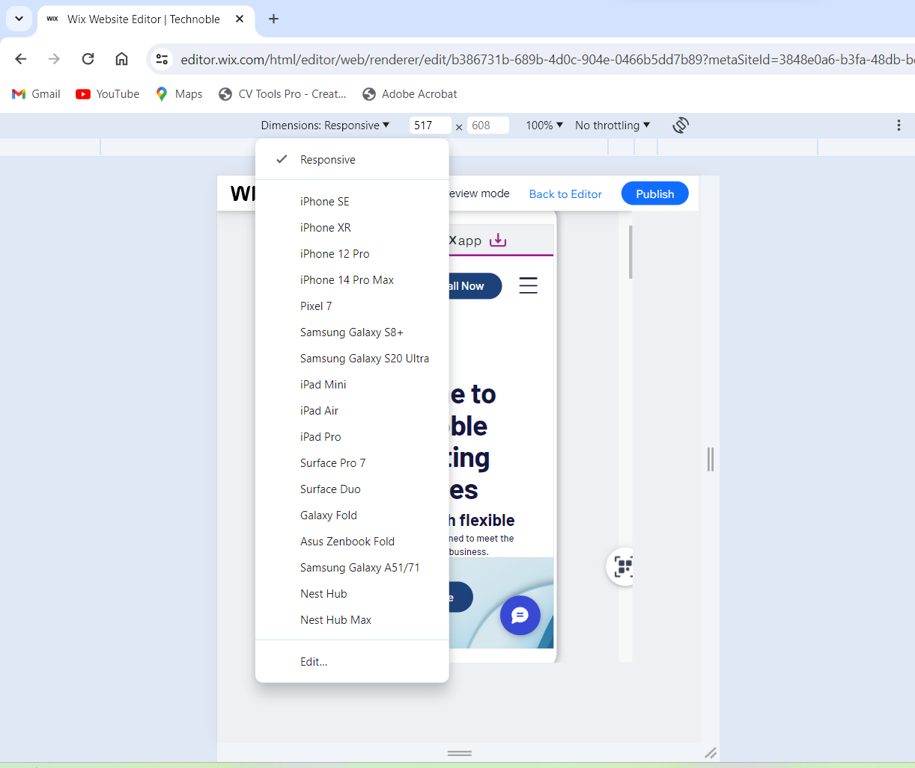
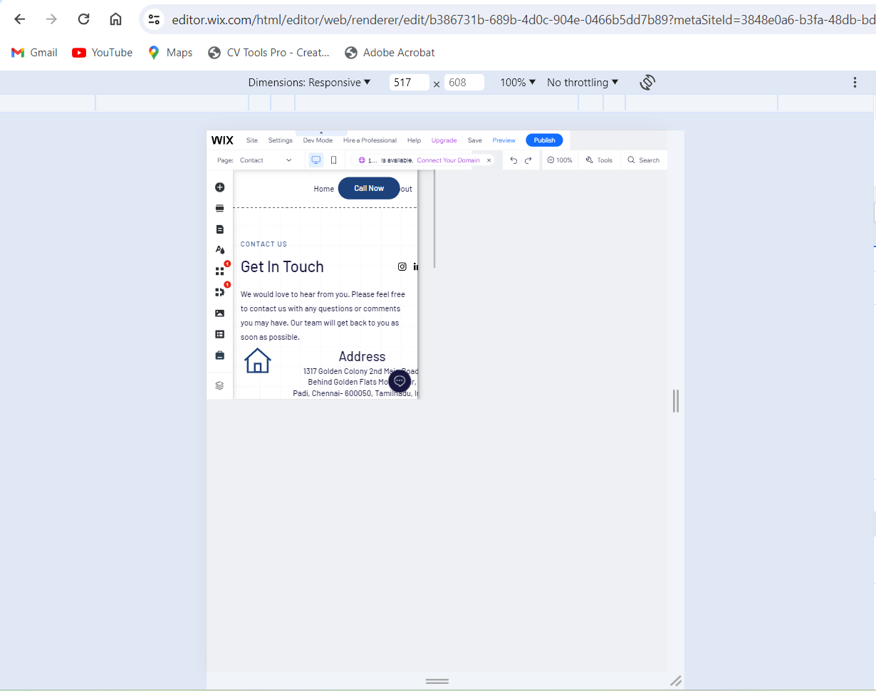
https://wix.to/VY8VtJ9

Slide 8
Provide a list of best practices for creating visually appealing and user-friendly website designs.
Below are the 5 major drawbacks I saw on the older website that the company had.
Cluttered Layouts:
Overloading a webpage with too much information, images, or an excessive number of colors and fonts can overwhelm users, making it difficult for them to find what they need. Aim for a clean, organized layout that guides visitors through your content seamlessly.
2. Poor Navigation:
Navigation should be intuitive. Complex or inconsistent navigation can confuse visitors, making it hard for them to locate specific information. Ensure your menu is easy to find and use, and consider including a search function for larger sites.
3. Lack of Clear Call to Action (CTA):
Every page should guide users towards a specific action (e.g., signing up, making a purchase). Vague or missing CTAs can result in missed conversion opportunities.
4. Poor Quality Content:
Content that is irrelevant, outdated, or riddled with errors can damage your brand's credibility. Ensure your content is engaging, accurate, and updated regularly.
5. Slow Loading Times:
Websites that take too long to load can frustrate users and increase bounce rates. Optimize images, leverage browser caching, and minimize the use of heavy scripts and plugins to improve loading times.

Slide 9

Design a landing page for their product or service to generate leads
www.reallygreatsite.com

Slide 10
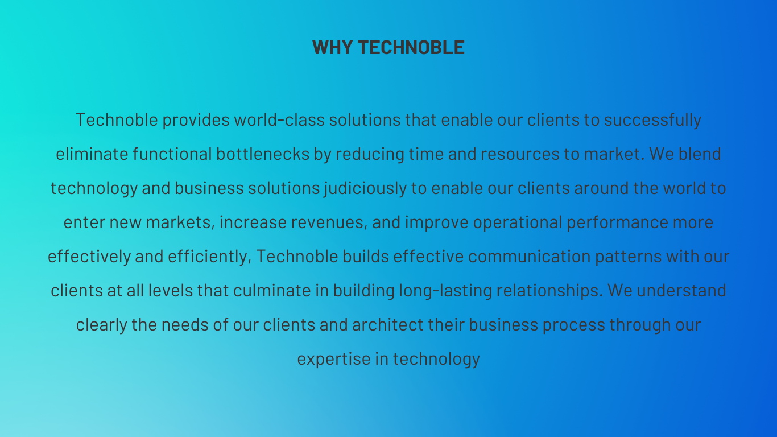

Slide 11
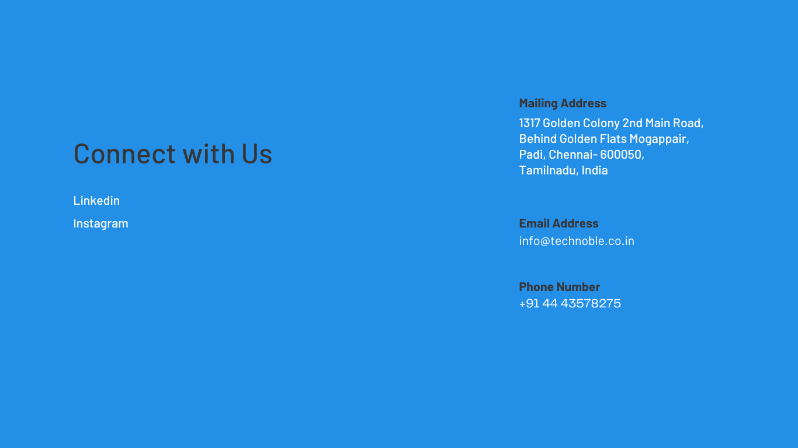

Slide 12
THANK YOU
PRESENTED BY THARUNA

